Slide 1
Research introduction
Yifan Yang（Rayford）
Email: yyang295@usc.edu
Phone Number: 213-590-8972

Slide 2
TABLE OF CONTENTS
01
02
03
04
Self Introduction
Introduction to current research
Past research experience
Questions and Answers

Slide 3
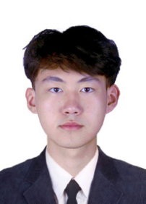
Part one-Self Introduction
University of Southern California
Master of Science, Spatial Data Science Expected May 2024
Hainan University
Bachelor of Engineering, Software Engineering September 2018 - June 2022
Why Phd:
I am deeply influenced by people such as Liu Bei, Zhou Enlai and Qian Xuesen. I admire their ambitions, feelings for home and country, and their spirit of never giving up. My career ideal is to become a professor and try to influence society and change the world. I think the most interesting thing about studying for a PhD is communicating and collaborating with the most active people in the academic world. The exchange of ideas between each other will create a new world. For me, studying for a PhD is a necessary way to improve my academic abilities and make greater contributions to society. I am not good enough now, and the way to becoming a PhD will bring me closer to my dream.
Yifan Yang

Slide 4
My skills
Applications: Esri ArcGIS Pro, Microsoft Office Suite, MS Access, MS SQL Server, SQL Server Management Studio, PgAdmin, PostgreSQL & PostGIS, Visual Studio Code, Google Colaboratory
Languages: Fluent in Chinese (Mandarin), English (Advanced)
Programming: ArcGIS API (JavaScript, Python), JavaScript, C, C++, JAVA, Python, SQL
My research interests
The combination of spatial science and data science
Remote sensing and artificial intelligence
Machine learning and deep learning
GeoAI and spatial analysis

Slide 5
Part two-Introduction to current research
Urban Tree Initiative
Instructor: Prof. John Wilson, Prof.Yi Qi, Beau MacDonald GIS Project Specialist
The goal of our project is to build a shade model and automate this process using python scripts.
The reason for building this model is
What we want to study is what percent of the study area is shaded during the day?
Which areas within the same study area are significantly less shaded than other areas?
What percent of the busiest traffic/school route is obscured during the hottest hours of the day?
How much more shade would there be [time and area] if new trees were planted at these locations? (Predict how many new trees will need to be planted in the future)
Use shade models as input to conduct larger-scale analyzes of the effects of shades (e.g., the relationship between shade and heat)

Slide 6
Calculating Shade Contributions
A. Shade from elevation + freeways
B. Shade from elevation and freeways + buildings
C. Shade from elevation and freeways + buildings + trees
→ calculate shade from building and shade from trees (raster calculation)
A = Terrain & Freeway shade
B - A = Building shade
C - (A + B) = Tree shade
However,
We do not have a polygonal shapefile for the freeway. Although the DSM includes all surface features, the actual freeway is unclear. Therefore, we need to identify the freeway in the study area and separate the shapefile of the freeway. My final idea and goal is to convert the 2D freeway shapefile into a 3D model based on the elevation value. After obtaining the 3D model, you can use ArcGIS toolbox to calculate the shade area.

Slide 7
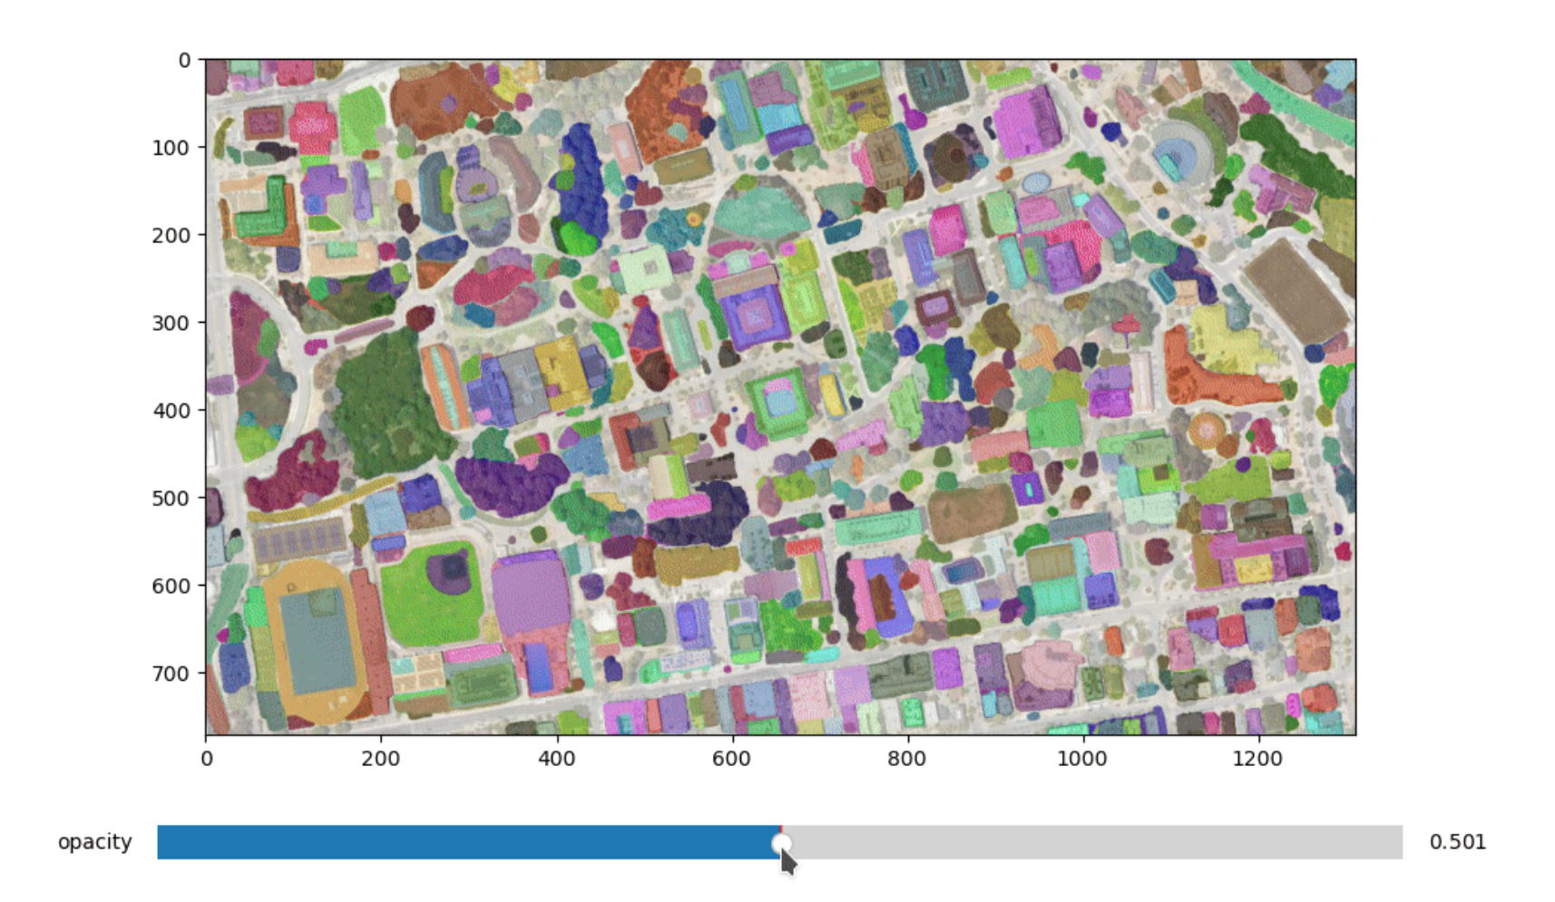
segment satellite imagery using the Segment Anything Model (SAM)
A new AI model from Meta AI that can "cut out" any object, in any image.
In the past, there was supervision, which specialized in solving specific problems in a certain field, such as segmenting cars.
GPT tells us one thing, we don’t need to focus on a specific downstream task.
Zero-shot ability is stronger than your ability to supervise
data generates data ---data engine
assisted-manual, semi-automatic, fully automatic--largest dataset in the world

Slide 8
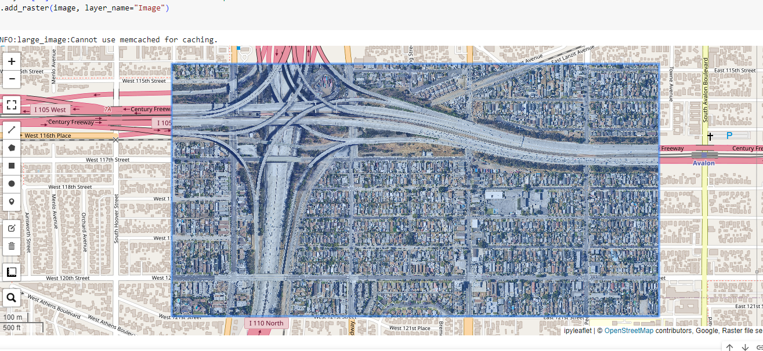
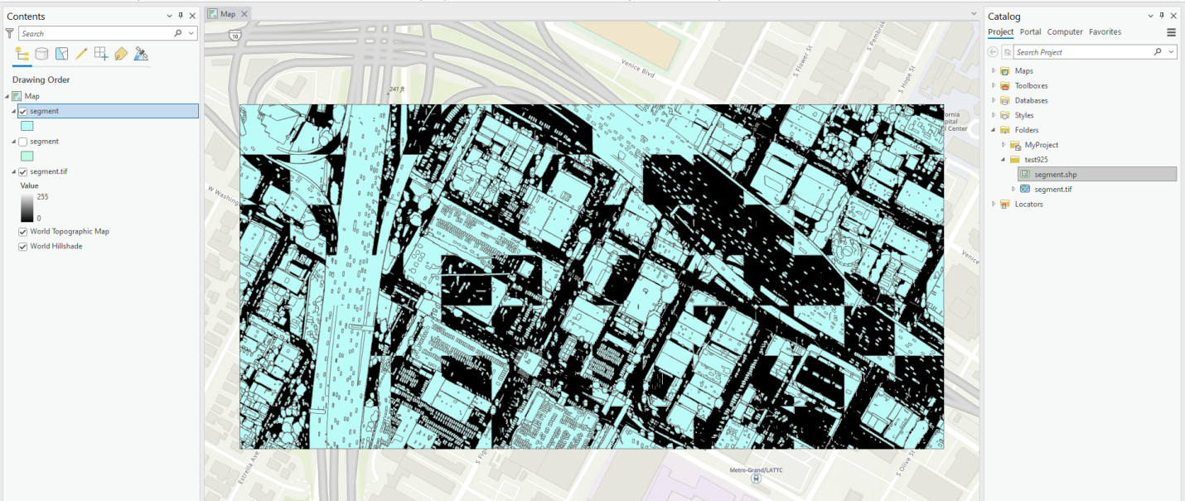
My research focuses on how to segment freeways from satellite images.
The picture above is before segmentation, and the picture below is after segmentation.
from the study area
desired_fids = [14041，] # FID
extracted_data = original_data[original_data['FID'].isin(desired_fids)]
extracted_data.to_file('path_to_save_extracted_data.shp')

Slide 9
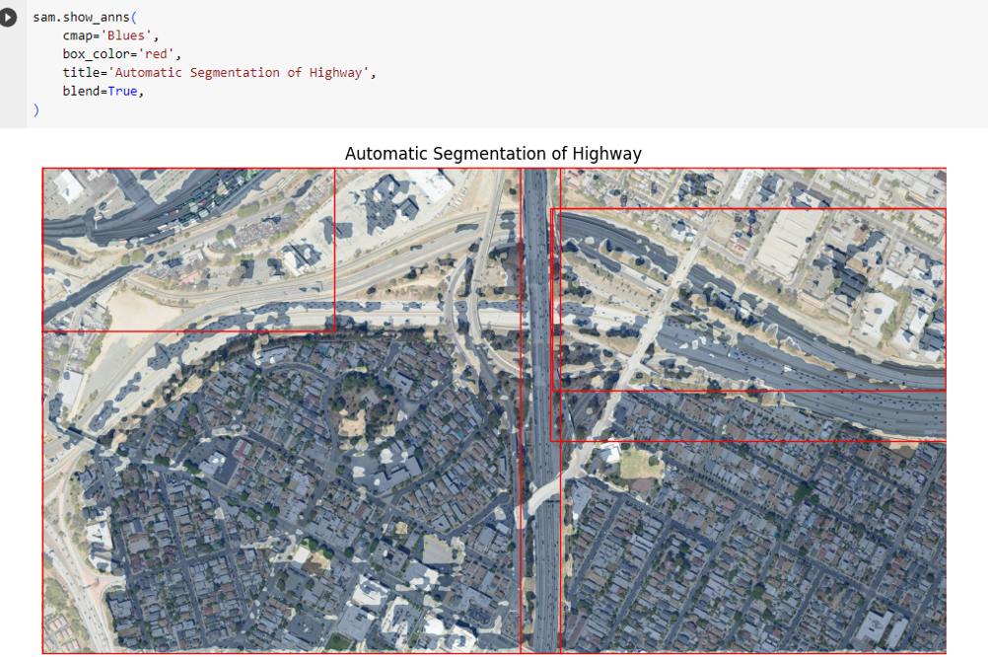
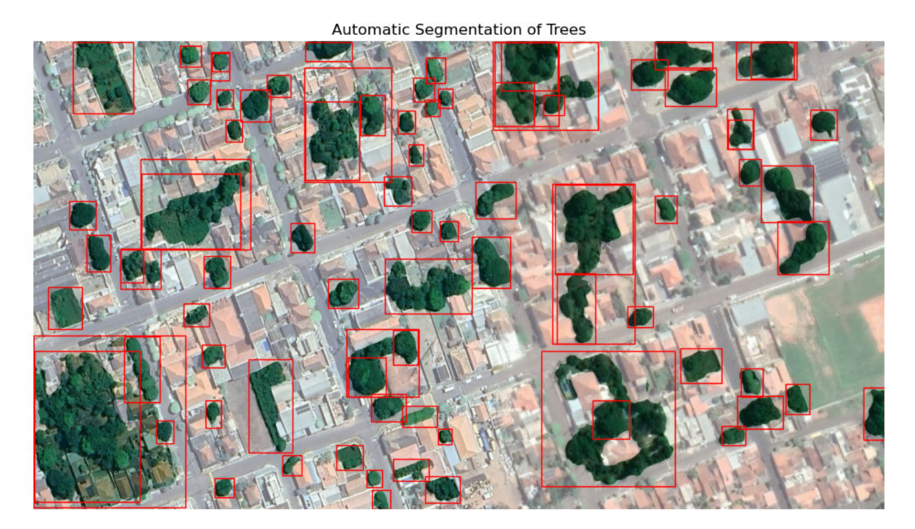
Grounding DINO Detect any target based on text prompts
When combining SAM and grounding dino, we can complete target segmentation and recognition, and we can directly obtain our target. ---langsam

Slide 10
Current thoughts
SAM and grounding-dino are the best methods for satellite image segmentation and detection under zero-shot learning.
They have strong generalization capabilities, but if they become too specific, training deep learning models may be needed.
I am trying to fine-tune the model. I am considering using a method similar to dreambooth for some objects with poor detection results, such as highways. The idea is to use some meaningless words, such as sssss, wsndinaibdc, to train freeways. , allowing the model to play a more significant role in the recognition effect of freeways.
The main thing is not to master those AI technologies, but to discover geospatial problems and use better technologies to solve these problems.

Slide 11
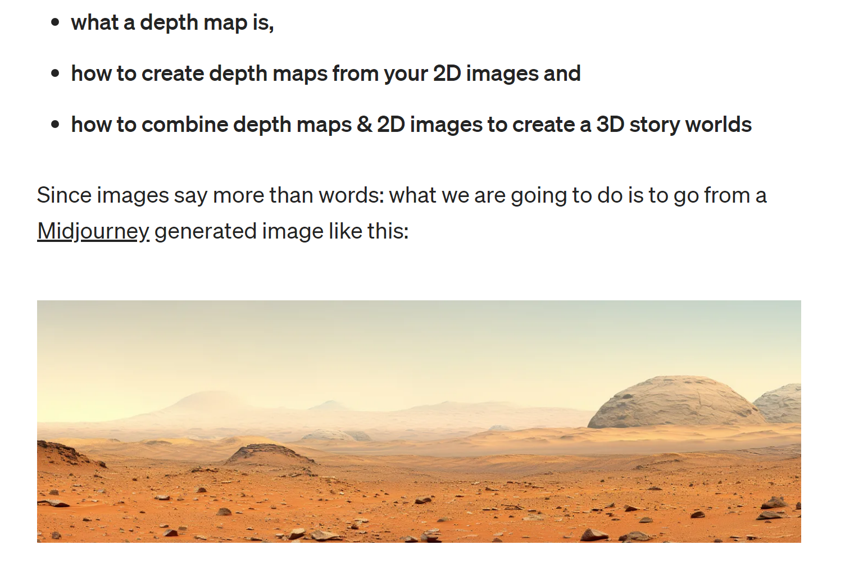
New observations and discoveries:
according to Hugging face
Instaverse can transform any 2D image into a complete 3D world.
I am a supporter of AI for science, and I believe that AI technology may have new impacts on traditional fields such as geography, space, environmental science, and agriculture. This requires interdisciplinary researchers.

Slide 12
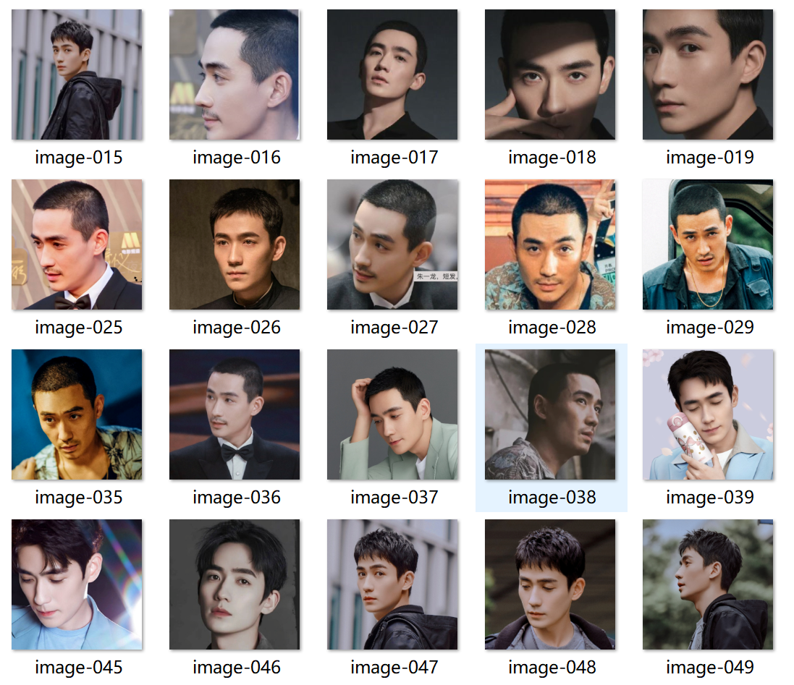
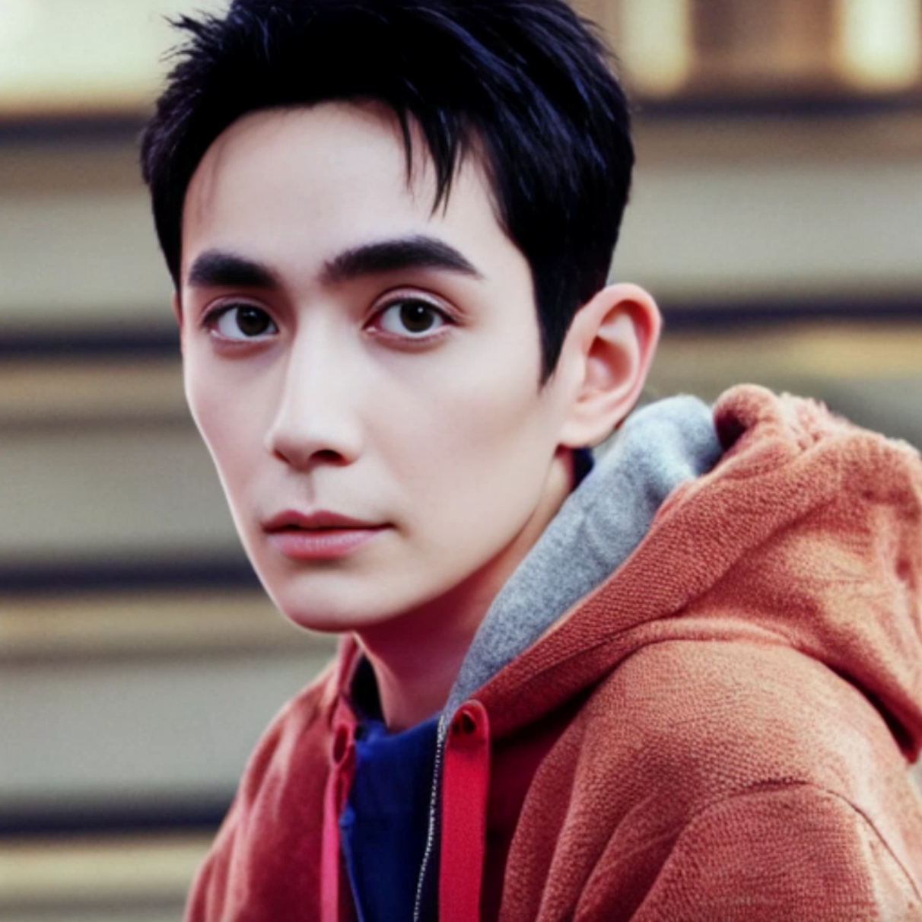
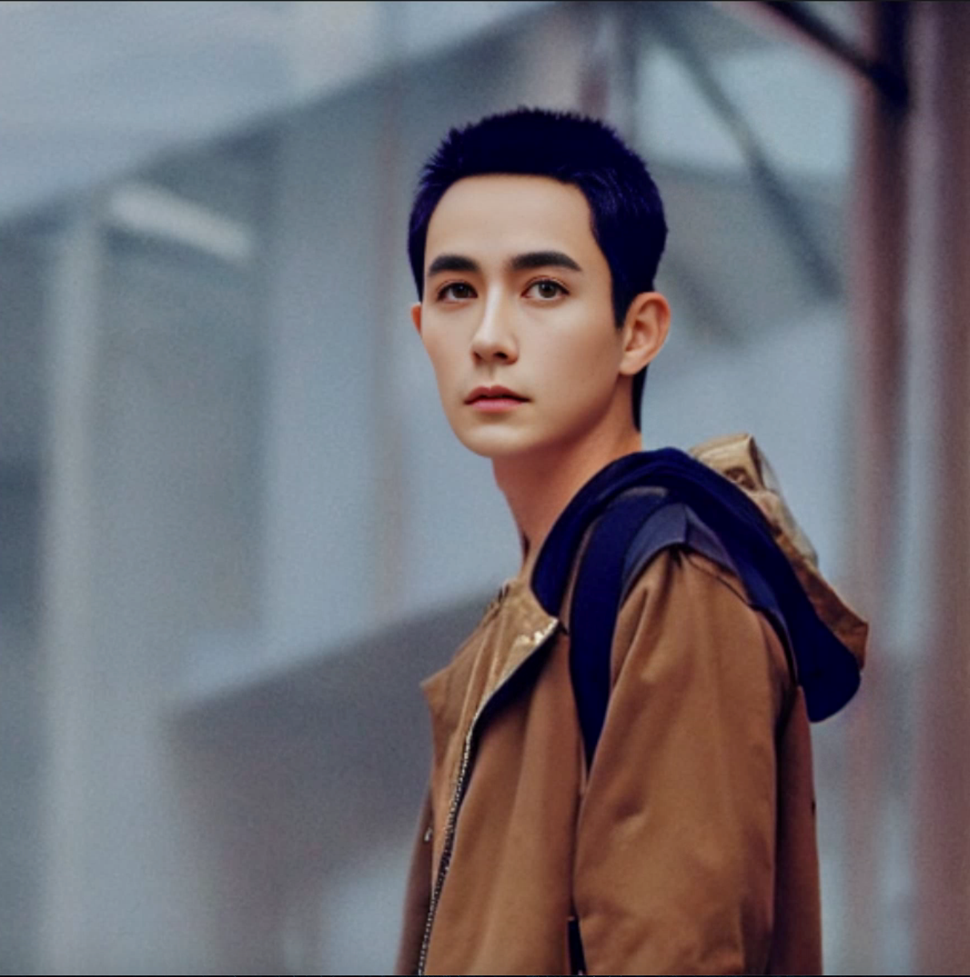
Part three-Past research experience
Internship experience
Generative AI, large model fine-tuning. Fine-tune Stable diffusion models using user-supplied datasets, using dreambooth, lora, etc.
Dataset pre-processing
Large model fine-tuning
Training and testing various configurations and parameters in ML applications
Experience working in the cloud (AWS)

Slide 13
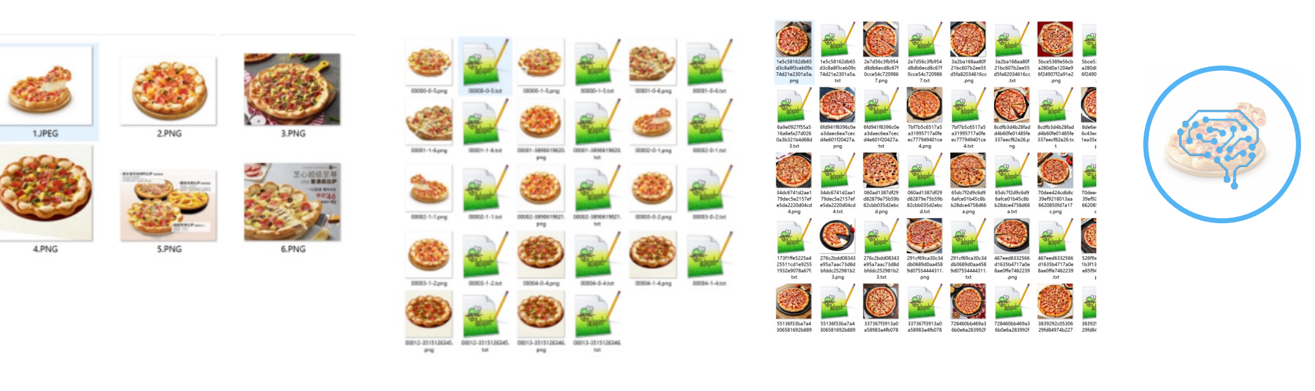
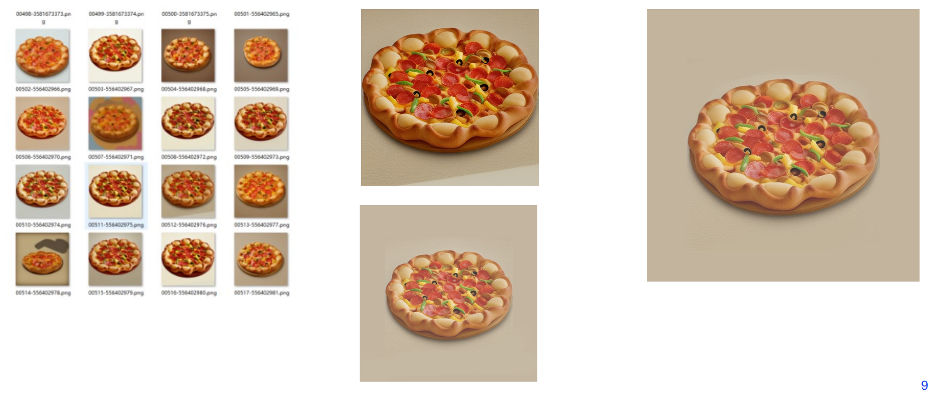
Part three-My professional skills and match（Why choose me）
Takeaways from the internship
1. Assist CTO with generative AI core dependent neural nets: model selection, development, tuning
2. Participate in the data engineering required for AI model fine-tuning, learning the entire process of data collection, data cleaning, data training, and AI model fine-tuning
3. Accumulate cutting-edge knowledge of generative AI.
4. Proficient in python programming, have a certain understanding of linux operating system, familiar with deep learning framework, pytorch, tensorflow, etc.

Slide 14
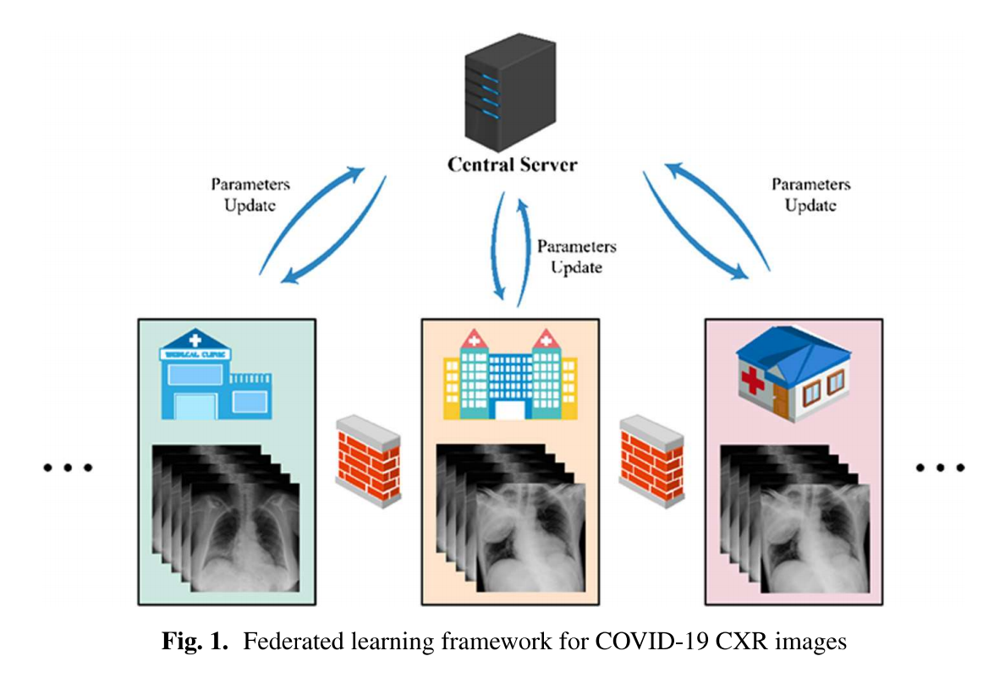
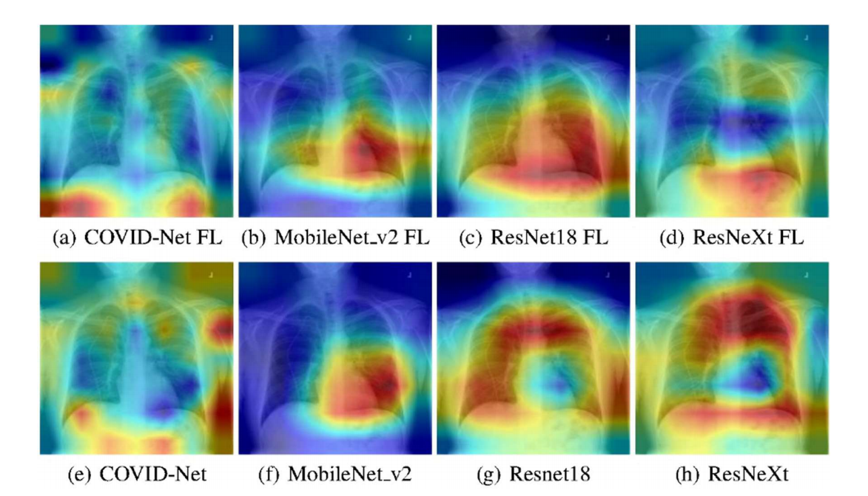
Part three-Past research experience
1. Computer vision and deep learning techniques were used to identify COVID-19 infections with chest X-ray images.
2. Hospital-specific medical-related data is not allowed to be leaked and shared without permission. Collecting such training data is a big challenge.
Research Name：
Experiments of Federated Learning for COVID-19 Chest X-ray Images.
Computer Vision and Pattern Recognition Machine Learning

Slide 15
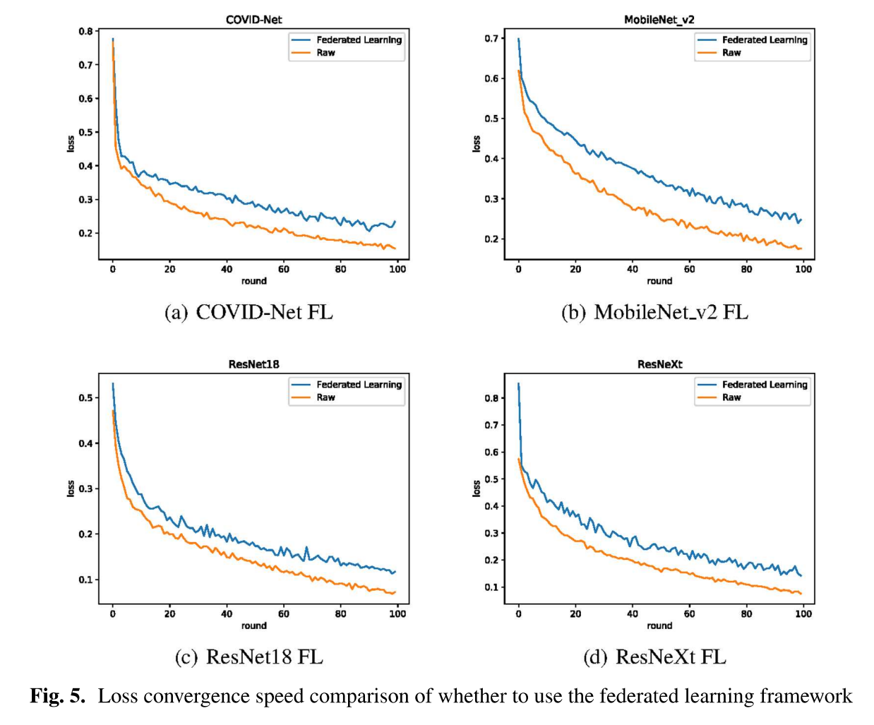
Part three-Past research experience
3. Federated Learning is an available approach to solve this problem. It can effectively solve the problem of data silos and get a shared model without obtaining local data.
4.The performance of four popular models (MobileNet, ResNet18, MoblieNet, and COVID-Net) is compared with and without the use of the Federated Learning framework.
The results of this research were successfully published.
[1]Yan, B. , Wang, J. , Cheng, J. , Zhou, Y. , Zhang, Y. , & Yang, Y. , et al. (2021). Experiments of Federated Learning for COVID-19 Chest X-ray Images. International Conference on Artificial Intelligence. Springer, Cham.

Slide 16
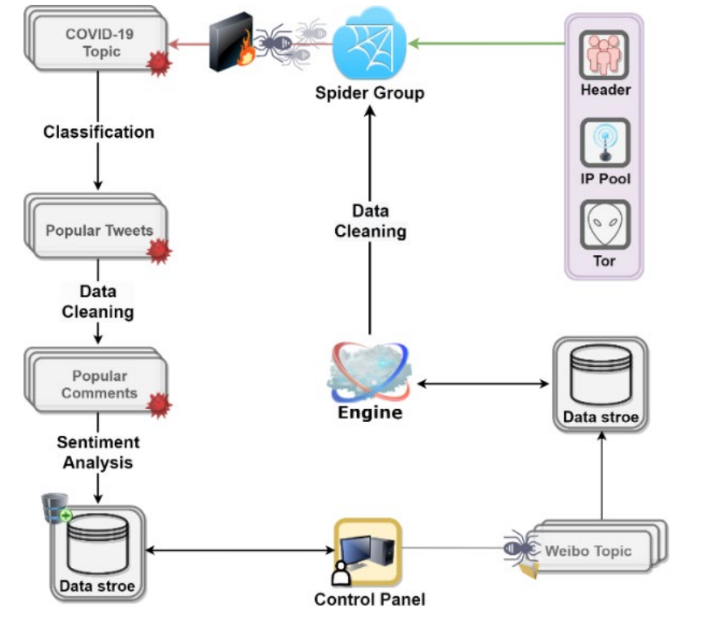
Research：
COVID-19 Public Opinion and Emotion Monitoring System Based on Time Series Thermal New Word Mining
1.Selected the "Scrapy-Redis" distributed crawler framework as the main workflow for crawling Weibo data, and used the Bloomfilter algorithm to filter URLs.
2.Phrases are segmented using existing corpus-based word frequency segmentation methods, and a Hidden Markov Model (HMM)-based Viterbi algorithm is used to determine the maximum probability segmentation scheme for out-of-word words.
3.Combined the Chinese Public Opinion Dictionary with Naive Bayesian Algorithm, and a public opinion classifier was constructed to process and analyze the epidemic comments on Weibo, and designed a large screen for data visualization.
•
Part three-Past research experience

Slide 17
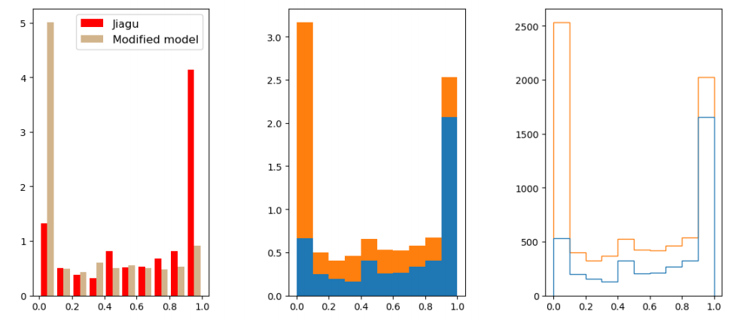
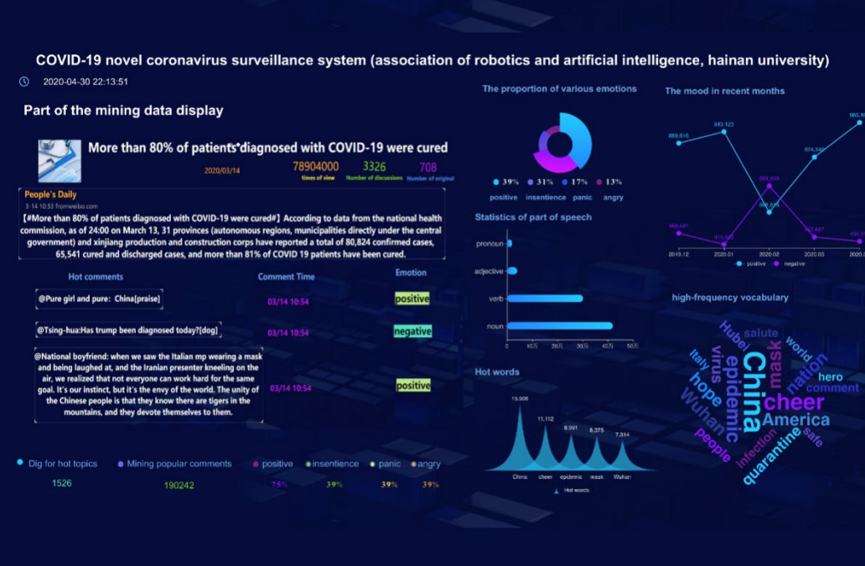
Part three-Past research experience
The results of this research were successfully published.
[2]Zhang, Y., Chen, J., Liu, B., Yang, Y., Li, H., Zheng, X., ... & Xiong, N. (2020). Covid-19 public opinion and emotion monitoring system based on time series thermal new word mining. arXiv preprint arXiv:2005.11458.

Slide 18
Part 04-Questions and Answers
Q1: As an undergraduate majoring in computer science and a graduate student in spatial data science. I think my knowledge in areas such as geography, environmental science and agriculture is lacking. How can I better supplement this knowledge? I always feel that I should not be a computer scientist.
Q2: I noticed that you also have a strong interdisciplinary background. For interdisciplinary applicants like me, do you have any advice before I apply for a PhD?

Slide 19
THANKS
I am very happy to have the opportunity to communicate with you and hope to learn and cooperate with you in the future.
yyang295@usc.edu
213-590-8972

